Slide 1
JOINT FAO-WFP INFORMAL MEMBERSHIP BRIEFING ON EMERGENCIES
FAO OFFICE OF EMERGENCIES AND RESILIENCE
WFP EMERGENCY OPERATIONS DIVISION

Slide 2
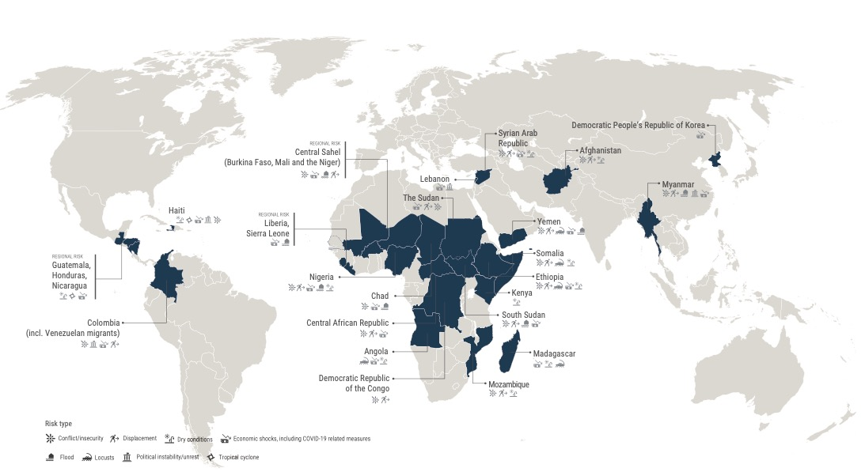
HUNGER HOTSPOTS
FAO-WFP early warnings on acute food insecurity, August to November 2021 outlook

Slide 3
UPCOMING TRENDS
Over 41 million people are now at risk of falling into famine or famine-like conditions, unless they receive immediate life-saving assistance.
Further upcoming deterioration likely across 23 hotspots.
New highest-alert hotspots: Ethiopia and Madagascar. South Sudan, Yemen and Nigeria remain highest alert level hotspots from the previous edition.
Chad, Colombia, the Democratic People’s Republic of Korea, Myanmar, Kenya and Nicaragua have been added to the list of hotspots.
Main drivers of food insecurity are conflict and insecurity, COVID-19 pandemic-induced economic shocks and higher international food prices, weather extremes and climate variability, transboundary threats, and access constraints.

Slide 4

COUNTRIES WITH CATASTROPHIC OUTLOOK
ETHIOPIA
Outlook: The Tigray region is at risk of famine. Key food security drivers are armed conflict, climate variability and weather extremes. Grave concern due to resumption of hostilities and obstructions to emergency assistance.
Key Recommendations:
Urgent flexible funding required to scale up aid operations
Unimpeded and sustained humanitarian access crucial to prevent famine
Unconditional cash and agricultural inputs to enhance production capacity and ensure a stable supply of nutritious food
2.1 M
(IPC PHASE 4*)
401 000
(IPC PHASE 5, projections July to September 2021)
*Tigray and neighboring areas of Afar and Amhara, May- June 2021.

Slide 5

COUNTRIES WITH CATASTROPHIC OUTLOOK
MADAGASCAR
Outlook: Worst drought in 40 years, coupled with fall armyworms and locust invasion, has led to low harvest in 2021, especially in the south. COVID-19 related income losses, with limited availability of staple foods and their increased prices are pushing people into extreme poverty.
Key Recommendations:
Urgent additional resource mobilization required to ensure continuation of emergency food and nutrition assistance
Urgently and immediately scale up emergency livelihood assistance, including in preparation for the upcoming agricultural season (provision of seeds and unconditional cash)
484 K
(IPC PHASE 4)
28 000
(IPC PHASE 5, projections October to December 2021)

Slide 6
COUNTRIES WITH CATASTROPHIC OUTLOOK
SOUTH SUDAN
2.4 M
(IPC PHASE 4)
108 000
(IPC PHASE 5)
Outlook: Populations in areas of South Sudan Pibor County have been facing famine likely conditions through July. There is a heightened risk of floods, and localized conflict continues to displace people.
Key Recommendations: Unimpeded and sustained humanitarian access in conflict-affected areas and supply corridors. Upscale emergency livelihood support, incl. vegetable and crop production kits, cash and vouchers, livestock treatment.
YEMEN
5.0 M
(IPC PHASE 4)
47 000
(IPC PHASE 5)
Outlook: The number of people in catastrophe (IPC Phase 5) was estimated to triple in Yemen by June. The risk of more people facing famine-like conditions may have been contained but any progress could be rapidly undone.
Key Recommendations: Upscale support to crop farmers and livestock keepers; continue desert locust surveillance and control operations. Mobilise support to revert to full humanitarian assistance across all governorates.
NIGERIA
798 K
(CH PHASE 4)
Outlook: The situation remains extremely concerning in conflict-affected areas of northern Nigeria. Populations in areas of Borno State may be at risk of catastrophic food insecurity.
Key Recommendations: Expand unimpeded humanitarian access to conflict-affected areas in the northeast, allowing for the lean-season scale-up of life-saving assistance. Improve agricultural production and nutrition through seeds distribution for rainy and dry season, livestock re-stocking, distribution of fish starter and processing kits, among other priorities.

Slide 7


HUNGER HOTSPOTS
AFGHANISTAN
Outlook: 8.6 million people expected to face IPC 3 (Crisis) and 3.5 million IPC Phase 4 (Emergency) from June to November. Situation may become more critical due to severe drought, rising displacement, intensification of conflict, COVID-19 secondary impacts, high food prices, and widespread unemployment.
Key Recommendations:
Urgent funding, diversified supply chain corridors, increased CBT, malnutrition prevention and treatment.
Maintain capacity to deliver assistance also in Taliban controlled areas and expand distribution of animal feed as well as winter wheat cultivation packages to mitigate expected production deficit.
CENTRAL SAHEL (BURKINA FASO, MALI AND THE NIGER)
Outlook: 6.5 million+ people projected to face acute food insecurity (CH Phase 3 and above) between June to August 2021 - Burkina Faso: 2.9 M, Mali: 1.3 M and Niger: 2.3 M. Consolidation and expansion of insurgent groups, economic impacts of COVID-19, and floods will affect food security.
Key Recommendations:
Strengthen humanitarian access in conflict-affected areas, to provide the necessary, consistent assistance and to mitigate additional populations’ movements.
Upscale emergency agricultural assistance to food insecure IDPs and host populations prioritizing low mobility agriculture and flood-receding crop cultivation; livestock protection and restocking; and cash transfers.

Slide 8


HUNGER HOTSPOTS
CENTRAL AFRICAN REPUBLIC
Outlook: 633 000 people expected to face IPC Phase 4 (Emergency) between April and August. Conflict and escalating violence in the northwest and central areas have led to 1.4 million IDPs. COVID-19 and the instability of the main supply road to Cameroon are causing slowdown in trade flows, leading to increases in food prices. Half the population is now acutely food insecure.
Key Recommendations:
Increased funding, unimpeded supply chain and humanitarian access is required to scale-up life-saving assistance to populations in areas of high food insecurity.
Distribute off-season crop inputs (vegetables; early maturing cassava cuttings) and unconditional cash in particular to food insecure IDPs, returnees and host communities.
CENTRAL AMERICA (GUATEMALA, HONDURAS AND NICARAGUA)
Outlook: Erratic and poor rainfall, especially in Dry Corridor areas, delayed planting and affected crops, now at risk of damage due to flooding during the hurricane season until November. Over 600 000 people facing IPC Phase 4 in Honduras; 174 000 in Guatemala, and between 250 000-500 000 in IPC 3 equivalent in Nicaragua.
Key Recommendations:
Provide emergency response and livelihood recovery support to hurricane-affected smallholder farmers and fisherfolk and expand CBT and food assistance programmes in the region.
Urgently support food production (water harvesting, micro-irrigation, seeds) in the postrera season to prevent further effects of drought and potential floods on food security.

Slide 9




STRATEGIC ASKS
Extraordinary Resource Mobilization
Timely, flexible and unearmarked funding, at a minimum including US$ 6 billion for emergency food assistance for famine relief and mitigation and US$ 600 million for targeted livelihood inputs.
Ensured Humanitarian Access
Additional assistance in ensuring that civilian populations can safely access life-saving assistance, and vice versa, particularly in situations of widescale insecurity and armed conflict, and adhering to UNSC Resolution 2417 (2018).
Urgent Lifesaving Assistance
Urgent food distributions to populations at risk of famine, accompanied by immediate targeted livelihood-saving interventions, malnutrition prevention and treatment programming, safeguarded supply chain of specialized nutritious foods and health and water services.
Strengthened Early Warning
Support and strengthen scenario planning, independent analysis, real-time monitoring and early warning mechanisms to track changes and anticipate crises to ensure the scaled-up action and the advocacy required to prevent a deteriorating situation.

Slide 10
Q&A
FAO OFFICE OF EMERGENCIES AND RESILIENCE
WFP EMERGENCY OPERATIONS DIVISION

